Slide 1
SECURE DATA HIDING IN IMAGES USING STEGANOGRAPHY
CAPSTOSECURE THE DATA TO PREVENT HACKERS
Presented By :P. AKASH
Student Name : P.AKASH
College Name & Department : HYDERABAD INSTITUE OF TECHNOLOGY AND MANAGEMENT & B. Tech(CYBER SECURITY)

Slide 2
OUTLINE
Problem Statement
Technology used
Wow factor
End users
Result
Conclusion
Git-hub Link
Future scope

Slide 3
Problem Statement
With the rise of cyber threats, ensuring secure data transmission is crucial. Traditional encryption methods attract attention, making hidden communication necessary. Steganography embeds secret data within images, but existing methods face challenges like low capacity and vulnerability to detection. This research aims to develop an efficient technique that enhances security, preserves image quality, and resists steganalysis attacks. The proposed approach will ensure covert and reliable data transmission over untrusted networks.

Slide 4
Technology used
Python – The core programming language for implementation.
OpenCV – Used for image processing, reading, and writing images.
NumPy (implicitly in OpenCV) – For handling image matrices.
File Handling (OS module) – Used for managing image files.
Character Encoding (ASCII Dictionary Mapping) – Converts characters into pixel values for embedding.
Basic Encryption (Password Protection) – A passcode is required for decryption.

Slide 5
Wow factors
1. Password-Protected Steganography
Unlike standard LSB steganography, your project requires a passcode to decrypt the hidden message, adding an extra layer of security.
2. Custom Character Encoding
Instead of directly modifying the least significant bits (LSB), your approach encodes characters using an ASCII-based dictionary, embedding them directly into the image pixels, making detection harder.
3. Dynamic Multi-Channel Embedding
Your project distributes the message across R, G, and B color channels, reducing visual distortion and increasing security compared to traditional LSB methods that modify only a single channel.
4. Error Handling for Image Size Constraints
It includes safeguards to prevent embedding messages that exceed the image's capacity, ensuring reliable data storage.
5. No Need for External Libraries for Cryptography
Instead of relying on cryptography libraries, the project cleverly integrates encoding techniques within the image structure itself, reducing dependencies.
6. Simple Yet Effective Implementation
The project is lightweight, easy to understand, and doesn't require high computational power, making it suitable for practical applications without heavy processing requirements.

Slide 6
End users
1. Cybersecurity & Intelligence Agencies
Used for secure and covert communication without attracting attention.
Helps in preventing data leaks and unauthorized access.
2. Journalists & Whistleblowers
Enables safe sharing of sensitive information without detection.
Helps avoid censorship and government surveillance.
3. Military & Defense Organizations
Used for confidential messaging in high-risk environments.
Reduces the risk of intercepted transmissions.
4. Corporate & Business Sector
Protects trade secrets and confidential reports from cyber threats.
Prevents unauthorized access to sensitive corporate data.
5. Digital Forensics & Law Enforcement
Helps in embedding crucial case information inside images for secure storage.
Used for securing evidence without raising suspicion.
6. General Users Concerned About Privacy
Individuals who want to hide personal data like passwords or messages securely.
Useful for secure messaging on untrusted networks.

Slide 7

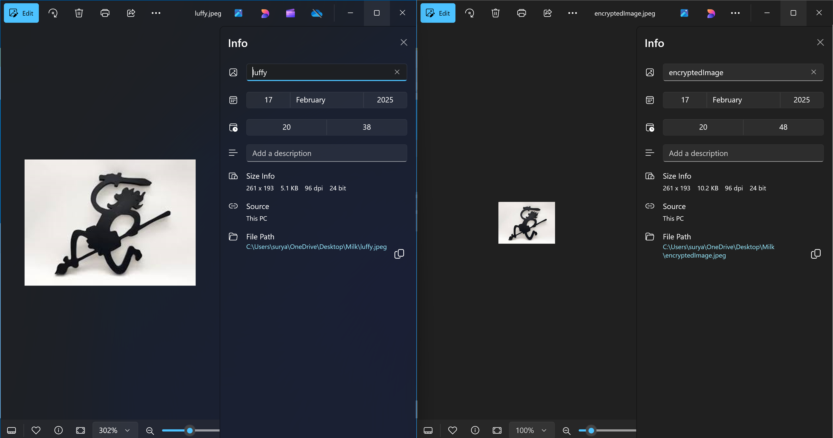
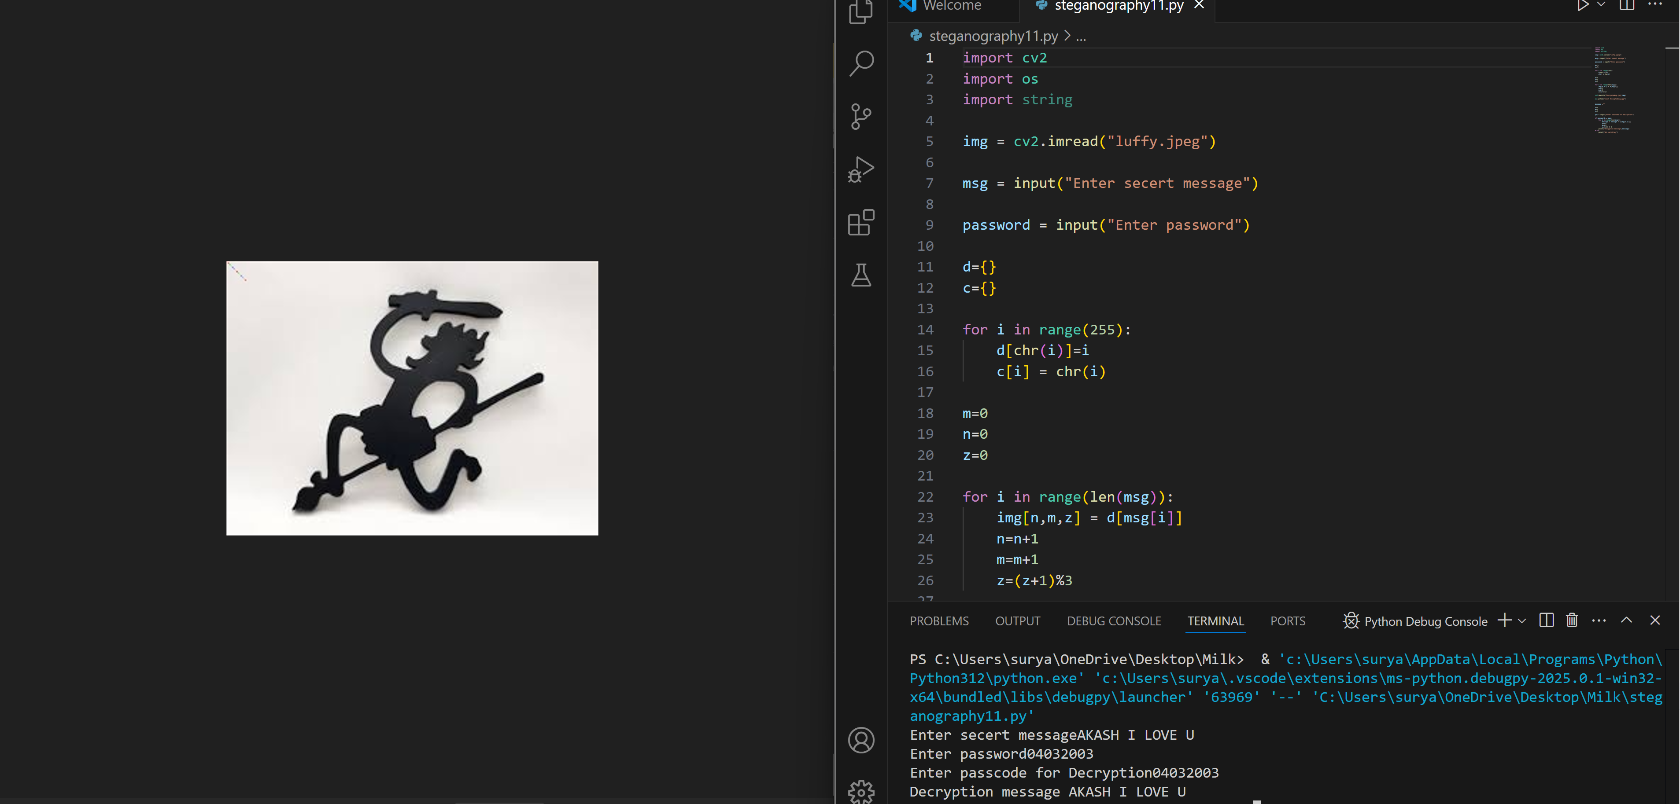
Results

Slide 8
Conclusion
This project successfully implements secure data hiding in images using steganography, ensuring confidential communication while maintaining image integrity. By incorporating password protection, multi-channel embedding, and custom character encoding, it enhances security and reduces detection risks. The method addresses challenges like payload limitations, unauthorized access, and image distortion, making it useful for cybersecurity, intelligence, and personal privacy. With further improvements like AI-based steganalysis resistance, it can become even more robust. Ultimately, this approach provides a secure, efficient, and undetectable way to transmit sensitive information.

Slide 9
GitHub Link
https://github.com/21E51A/Steganography

Slide 10
Future scope(optional)
The future scope of this project includes AI-powered steganalysis resistance to prevent detection and advanced encryption (AES/RSA) for enhanced security. Adaptive steganography can improve undetectability by dynamically selecting embedding regions. Cloud integration (Azure, AWS) can enable secure storage and transmission of steganographic images. A mobile or web-based platform can make the system more accessible for real-time secure messaging. Additionally, blockchain integration can ensure data integrity and track modifications.

Slide 11

THANK YOU

